Slide 1
ETRSS-1 Power Supply Subsystem Design
DFH SATELLITE CO.,LTD
February, 2019

Slide 2
Abbreviations
PSS Power Supply System
SA Solar Array
PCDU Power Control/Distribution Unit
BOL Beginning of Life
EOL End of Life
DTS Data Transmission system
GS Ground station
DOD Depth of Discharging
BMU Battery Management Unit

Slide 3


OUTLINES
Concept and Function
Compositions of PSS
Work principles of PSS
Power balance analysis
Telemetries and Tele-commands

Slide 4
Concept and Function
Power Supply System, PSS for short, could be directly equated with the heart of the satellite.
PSS generates，reserves, transforms, regulates and distributes the electrical power on satellite.
PSS
Function
&Concept
PSS carries out the conversion of the light energy or chemical energy into electrical energy by means of certain physical change or chemical change.
PSS takes on the power supply and distribution for the platform and payloads during the testing, launching and orbiting.

Slide 5

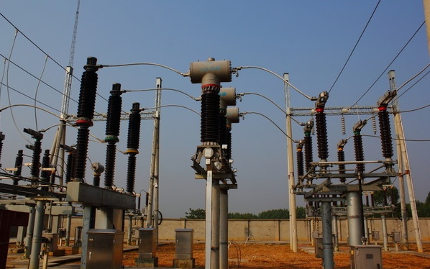
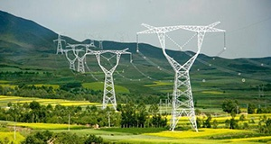
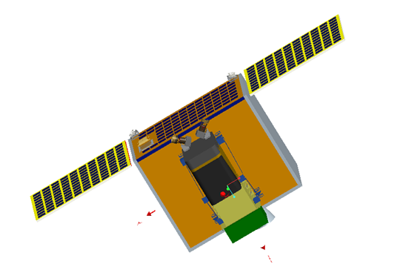
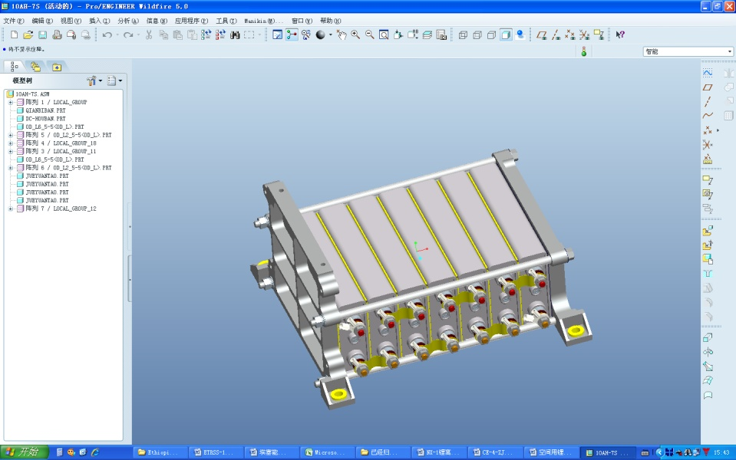
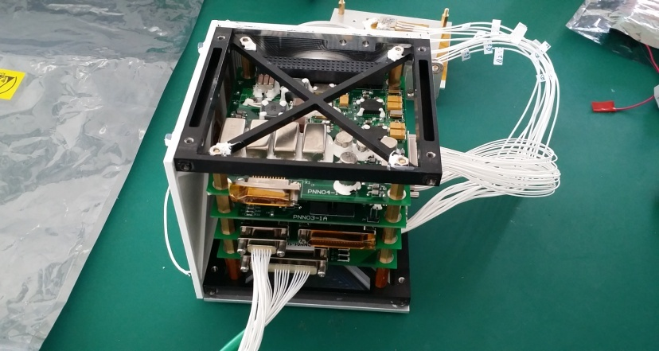
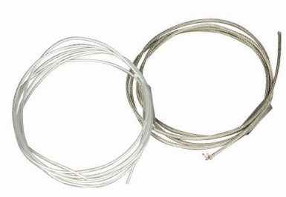
Concept and Function
On the Ground
Power Plant
Transformer Substation
Networks
On the Satellite
Batteries
Power Control/Distribution Unit
Cables

Slide 6
Concept and Function
Technical Specification
Power Bus Number
A single primary power bus is configured.
Type of Voltage
Non-regulated power bus
Voltage of Power Bus
Primary power bus: +23V ~ +29V
Output power
151W at the end of life (EOL)

Slide 7
OUTLINES
Concept and Function
Compositions of PSS
Work principles of PSS
Power balance analysis
Telemetries and Tele-commands

Slide 8
Compositions of PSS
A Solar Array-battery united electrical power system has been adopted.
PSS working Principle
When the output current of solar-arrays is greater than load currents , the output power of solar-arrays is supplied to loads and charged to batteries simultaneously.
When the output current of solar-array is greater than the sum of the load currents and charging current, the redundant energy will be shunted by shunt regulators after charging and power supply.
Light
When the output current of solar-arrays is less than load currents in light, the loads will be supplied by the joint-power supply consisted of solar-arrays and batteries.

Slide 9
Compositions of PSS
PSS working Principle
Since the solar-arrays have no output power in umbra, the loads will be supplied by batteries totally.
.
Umbra
Charge
Launching
There will be no power supply by batteries or solar arrays during launching and orbiting before the expansion of solar-array.
Discharge
Shunt

Slide 10
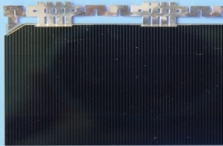
Compositions of PSS ( Solar Array)
Solar energy
photovoltaic conversion
Electric energy
Composition
The whole solar-arrays are composed of many solar cells by series connection and parallel connection compound used in order to obtain voltage and current required.
Solar cell type
Triple-junction GaAs solar cell
Wing number
Three solar panels --- one panel for surface-mounted and two fixed solar wings with one panel for each other
2
Solar Array size
The total area of the whole solar-arrays is 0.70m that could meet the power requirements.

Slide 11
Compositions of PSS ( Battery)
The structure of batteries is composed of several rechargeable battery cells to gain the voltage and current needed.
Battery cell type
Cell number
Battery capacity
Lithium-ion battery
7 cells
10 Ah
Higher power and energy density
Wider temperature range
Higher charging efficiency and better durability
7 cells series connection
Total capacity 10 Ah.

Slide 12
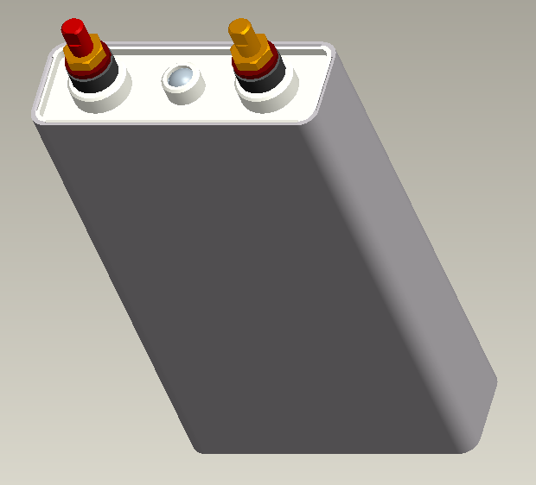
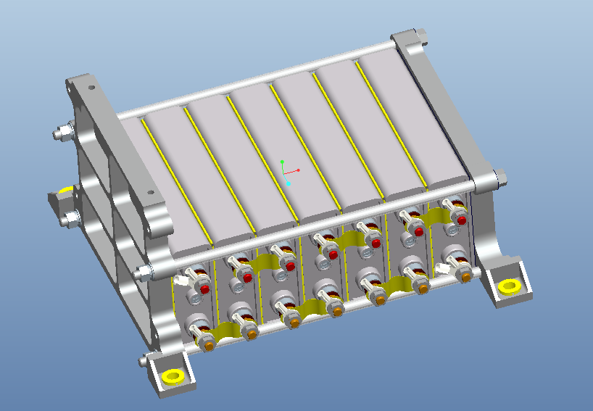
Compositions of PSS ( Battery)

Slide 13
Compositions of PSS ( PCDU)
PCDU: Power Control / Distribution Unit
To control electrical power distribution to the other subsystems during the mission life.
✓ To support power requirements for average and peak electrical load.
✓ To interconnect all equipment and subsystems.
Function
6 Standard PC104 boards: Power shunting board
Power interface board
Power sub-computer boards
Power distribute boards
All these boards are integrated in a PC104 stackable structure.
Composition

Slide 14
Compositions of PSS

Slide 15
OUTLINES
Concept and Function
Compositions of PSS
Work principles of PSS
Power balance analysis
Telemetries and Tele-commands

Slide 16
Work principles of PSS
Battery charge
A constant-current to constant-voltage charging method, CC-CV for short, has been adopted for the lithium ion batteries.
A certain small charging current predesigned has been reached.
C C
C V
END
Constant Current
Constant
Voltage
Charging will be stopped.
Charging voltage of the single cell has
reached a predesigned voltage, such as 4.0V.

Slide 17
Work principles of PSS
Battery charge
Over-charge must be forbidden during the lithium ion batteries charging.
Lead to the gas production and temperature increase created by decomposition of organic electrolyte inside batteries.
Cause the increase in pressure inside the battery and more seriously, an explosion may take place.
Disadvantage

Slide 18
Work principles of PSS
Battery balance
The cell will be a serious imbalance compared with other cells after many charging discharge cycles.
V
The overcharge method could not be used to reach the balance between battery cells.
A balance charging control circuit in battery charge regulator is adopted to ensure the performance balance.
1
2
3
4
5
6
7

Slide 19
Work principles of PSS
Battery discharge
Over-discharge still would not be allowed.
Change the lattice of structure of the cathode materials
Oxidize the current collectors of negative electrode
Result in performance degradation and conductivity decreasing
Disadvantage

Slide 20
Work principles of PSS
When the voltage of battery cell is less than a certain predesigned value, such as 3.0V, the batteries will be disconnected from the power bus to stop discharging by control circuit.
Discharging
Strategy
Specification
The smaller the discharge of depth is, the longer the life of batteries has.
In order to ensure the life time of the lithium ion batteries on the satellite, we should pay much attention to the DOD with the requirement of less than 30%.

Slide 21
Work principles of PSS
Distribution
Direct-current power distribution.
A kind of sectional power supply has been adopted.
Direct power
distribution
The equipments will be powered on as long as the satellite is powered on, which include PDU, the equipments in OBDH and TT&C.
Switch control
power distribution
The equipments should be powered on by commands after the satellite is powered on, which include AOCS, DTS and CS.

Slide 22
Work principles of PSS
Energy security mode
Battery Voltage
Battery Capacity
Parameters
Condition 1: Battery Voltage ≤ Batt_Voltage_Alarm_ THRESHOLD (Default value 25.2V)and the time of duration ≥ 30s.
Condition 2: Battery Capacity ≤ Batt_Capacity_Alarm_ THRESHOLD (Default value 6Ah)and the time of duration ≥ 30s.

Slide 23
OUTLINES
Concept and Function
Compositions of PSS
Work principles of PSS
Power balance analysis
Telemetries and Tele-commands

Slide 24
Power balance analysis
The necessary condition and important guarantee of the satellite working reliability
Purpose
On the premise of the designs of solar-arrays and batteries, a good PSS would be judged by energy balance analysis whether it is in the state of energy balance or not in one or some orbits.

Slide 25
Power balance analysis
In umbra: The loads get the electrical power by battery discharging.
In light : The electric power generated by solar arrays will be used for power supply and battery charging which has been consummated during the umbra.
Lead to the battery over-discharge.
Result in performance degradation and conductivity decreasing
Cause the abnormal situation of the equipments because of the energy shortage.
Non-balance
Disadvantage

Slide 26
Power balance analysis
At the end of life, during the longest time of umbra, when one battery cell is invalid, the DOD (Depth of Discharging)of the batteries should not be more than 30%.
Conditions
During the shortest time of light, the output power of solar-arrays should not only be enough for the loads power, charging power and power loss in circuits, but also have some power margin.

Slide 27
Power balance analysis
Long-term: SA sun-pointing
Operation modes: SA earth-pointing
Modes | Discharging Capacity (Ah) |  | Need to charge capacity (Ah) | Chargeable capacity (Ah) | Capacity margin (Ah) | Depth of discharge (%) | Balance
 | Umbra | Light
Long-term | 1.62 | 0 | 1.62 | 2.97 | 1.35 | 16.20% | YES
Record | 1.62 | 0.18 | 1.80 | 2.33 | 0.53 | 18.03% | YES
Replay in light | 1.62 | 0.46 | 2.08 | 2.24 | 0.16 | 20.80% | YES
Replay in umbra | 2.12 | 0 | 2.12 | 2.97 | 0.75 | 21.21% | YES
Record and Replay | 1.62 | 0.26 | 1.88 | 2.52 | 0.64 | 18.84% | YES
Real-time | 1.62 | 0.26 | 1.88 | 2.52 | 0.64 | 18.84% | YES

Slide 28
Power balance analysis
Requirement：one circle power balance
and DOD ≤ 30%
Chargeable capacity calculation
Chargeable power under long-term load condition
Chargeable power under short-term load condition

Slide 29
Power balance analysis
Discharge power calculation
Discharge power in umbra including long-term and short-term loads
Discharge power in sunlight period when PSA< Pload
Depth of Discharge
DOD = Q _{discharge}/ Q _{battery capacity}

Slide 30
Power balance analysis
Parameters for power balance analysis
No. | Items | Parameters
1 | Long-term load | 70W
2 | Max umbra period | 34.8min
3 | Min light period | 62.65min
4 | power supplied by solar array | 151W
5 | Battery discharge voltage | 3.60V
6 | Battery charge voltage | 4.10V
7 | Battery Series number | 7
8 | Battery capability (total) | 10Ah
9 | Discharge line loss factor | 97%
10 | Charge/discharge ratio | 1.01
Power budget
Sunlight and orbit condition
SA output power(EOL)
Parameters about battery
Various efficiencies

Slide 31
OUTLINES
Concept and Function
Compositions of PSS
Work principles of PSS
Power balance analysis
Telemetries and Tele-commands

Slide 32
Key Telemetry Parameters
According to the importance of different telemetries, transmission periods of TMs are still different.
Quick changing telemetries ( per 2 seconds )
Telemetries Type
Slow changing telemetries (per 16 seconds / 4 seconds )
There are 27 quick changing telemetries and 32 slow changing telemetries in PCDU.

Slide 33
Key Telemetry Parameters
Quick changing telemetries in PCDU
# 28V Bus Voltage 23V～29V
# +12V Bus Voltage 10V～13V
# +5V Bus Voltage 4.5V～5.5V
# -12V Bus Voltage -10V～-14V
# Battery Voltage 23V～29V
# Load Current 0A～6A
# SA Output Current 0A～7A
# Charge Current 0A～5A
# Discharge Current 0A～6A
# Battery temperature 1 0ºC～35ºC
# Discharge Relay Status 0：ON，1：OFF
# -Y Wing Deployment Status
1：Deployed，0：Folded
# +Y Wing Deployment Status
1：Deployed，0：Folded
# Battery Heater Status 0：ON，1：OFF
# Over-discharge Flag
0：Normal，1：Over-discharge
# BMU Status 0：OFF，1：ON

Slide 34
Key Telemetry Parameters
Slow changing telemetries in PCDU
# Battery current capacity
# Battery charge capacity
# Battery discharge capacity
# Power Alarm Status
# Sub Computer Selfcheck Status
# Sub-computer Status
# Heater Stop Temperature/ Heater start temperature
# Charge/Discharge Ratio
# Batt Voltage Alarm Threshold
# Batt Voltage Pre-alarm Threshold

Slide 35
Key Tele-commands
OBDH _M ON
Transponder A_ON
OBDH _B ON
Transponder A_OFF
Batt_Discharge_Relay_CLOSE
Transponder B_ON
Batt_Discharge_Relay_OPEN
Transponder B_OFF
Overdischarge_s/w_ENABLE
Overdischarge_s/w_DISABLE
Batt_Connect_s/w_ENABLE
Batt_Connect_s/w_DISABLE

Slide 36
Data blocks for PCDU
Charge parameters block
If the injection parameter is 00H, the parameter will keep as it was without changing.
Charge parameters block
Bit | Data | Annotation
0 | ##H | 55H : data block
1 | ##H | 01H: charge parameters block
2 | ##H | Charge/Discharge Ratio
3 | ##H | Battery Current Capacity
4 | ##H | Battery Voltage Alarm Threshold
5 | ##H | Battery Voltage Discharge Alarm Threshold
6 | ##H | Battery Voltage Pre-alarm Threshold
7 | ##H | Battery Capacity Alarm Threshold
8 | ##H | AAH

Slide 37
Data blocks for PCDU
Heater control block
Bit | Data | Annotation
0 | ##H | 55H : data block;
1 | ##H | 02H: heaters control parameters block
2 | ##H | Temperature control mode D7D6：01-closed loop，10-open loop D5： 1- Heater start when open loop 0- Heater stop when open loop
3 | ##H | Heater stop temperature
4 | ##H | Heater start temperature
5 | ##H | AAH
6 | ##H | AAH
7 | ##H | AAH
8 | ##H | AAH

Slide 38
Key Telemetry Parameters in BMU
# Battery Voltage
# Batt_Cell 1 Voltage
# Batt_Cell 2 Voltage
# Batt_Cell 3 Voltage
# Batt_Cell 4 Voltage
# Batt_Cell 5 Voltage
# Batt_Cell 6 Voltage
# Batt _Cell 7 Voltage
# Batt_Cell1_Bal_Status
# Batt_Cell2_Bal_Status
# Batt_Cell3_Bal_Status
# Batt_Cell4_Bal_Status
# Batt_Cell5_Bal_Status
# Batt_Cell6_Bal_Status
# Batt_Cell7_Bal_Status
# Batt_Bal_s/w Status

Slide 39

Thanks!

